Slide 1

Geospatial Analysis of Brain Structure
Son Ha
Big Data Institute
University of Oxford
son.ha@spc.ox.ac.uk

Slide 2

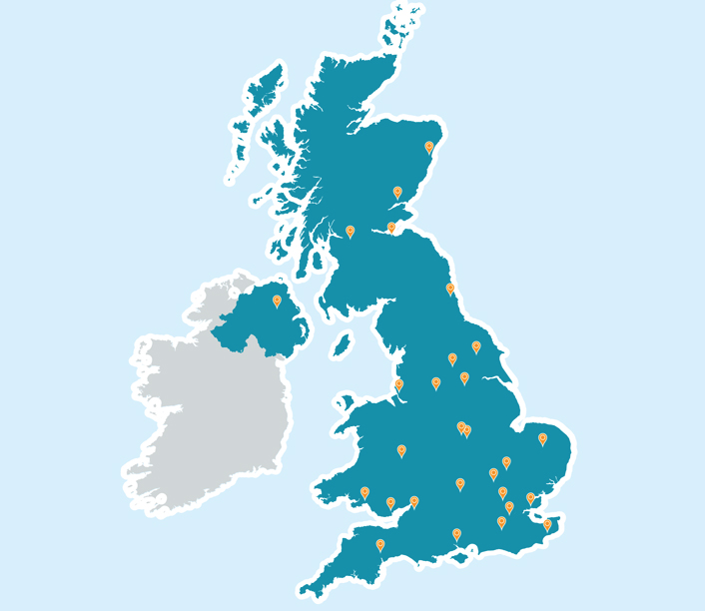
Overview of UK Biobank
UK Biobank is a world-wide health resource
Open to conduct researches that are in public interest
UK Biobank recruited 500,000 individuals from across the UK to take measurements and follow-up on their health

Slide 3
Overview
This project aims to investigate the relationship between the brain phenotypes and the geographical characteristics.
The investigation also considers specific regions of the brain that is related to dementia and try to relate those to geographical factors.

Slide 4
Data
The data is taken from the UK biobank from 20,000 subjects
They are divided into three groups: confounding factors, geospatial factors (variable of interest) and T1 MRI grey matter volume of various brain regions.
T1-weighted MRI, parcellated into 137 brain regions of interest using Harvard-Oxford Atlas
Cleaning data
Mean imputing missing data and creating dummy variables for categorical data
Combine columns with high correlation to deal with multicollinearity

Slide 5
Data
CONFOUNDING FACTORS
Age
Non-genetic sex
Body Mass Index
Number of Siblings
UK Biobank Assessment centre
Ethnicity
Average total household income before tax
Head Size (From T1MRI)
Age squared
Age times Sex
Age squared times Sex
GEOSPATIAL FACTORS
Home location east coordinate
Home location north coordinate
Place of birth east coordinate
Place of birth north coordinate
Townsend index
Distance nearest road
Traffic
Distance to coast
Air pol
Greenspace
Pop density

Slide 6
Method
Adjusting T1MRI data for confounding factors and their squares
Fitting brain region volumes, using ordinary least square, as outcome and geographical variables as the predictors of interest. We use linear model with linear and quadratic terms to fit.
P - value of each fit is calculated with t-statistics
Multiple Comparison Error is controlled with false discovery rate.

Slide 7
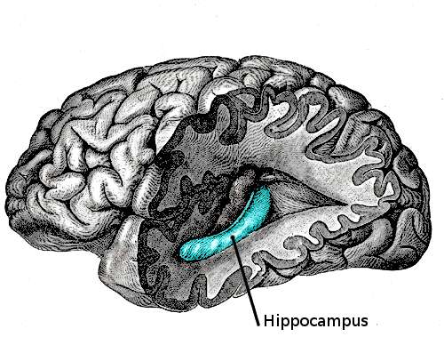
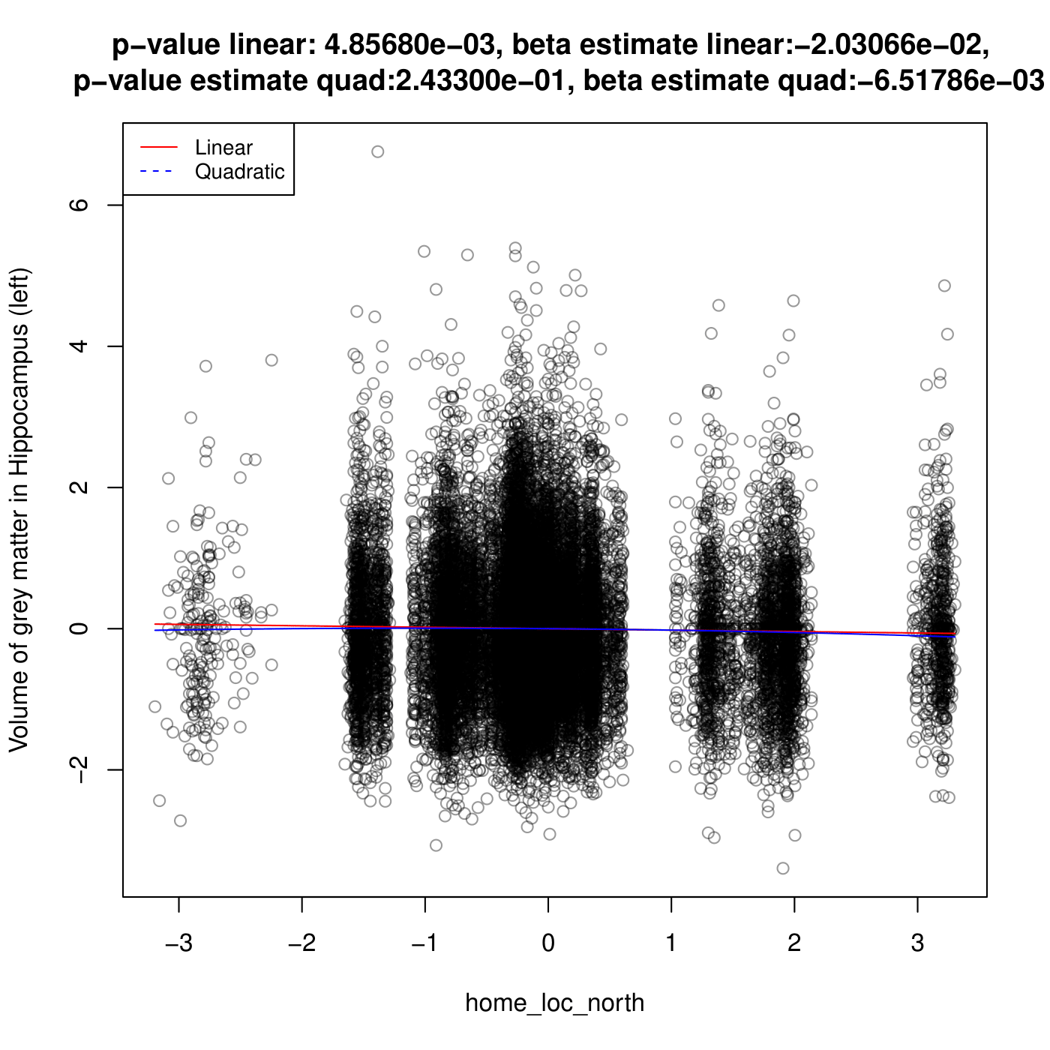
Left hippocampus against home location (north coordinate)
In Alzheimer’s disease, or commonly in ageing, the hippocampus grey matter volume shrinks
The association is relatively weak: We observe significance due to our large sample size, or there are association, but it is quite weak.

Slide 8
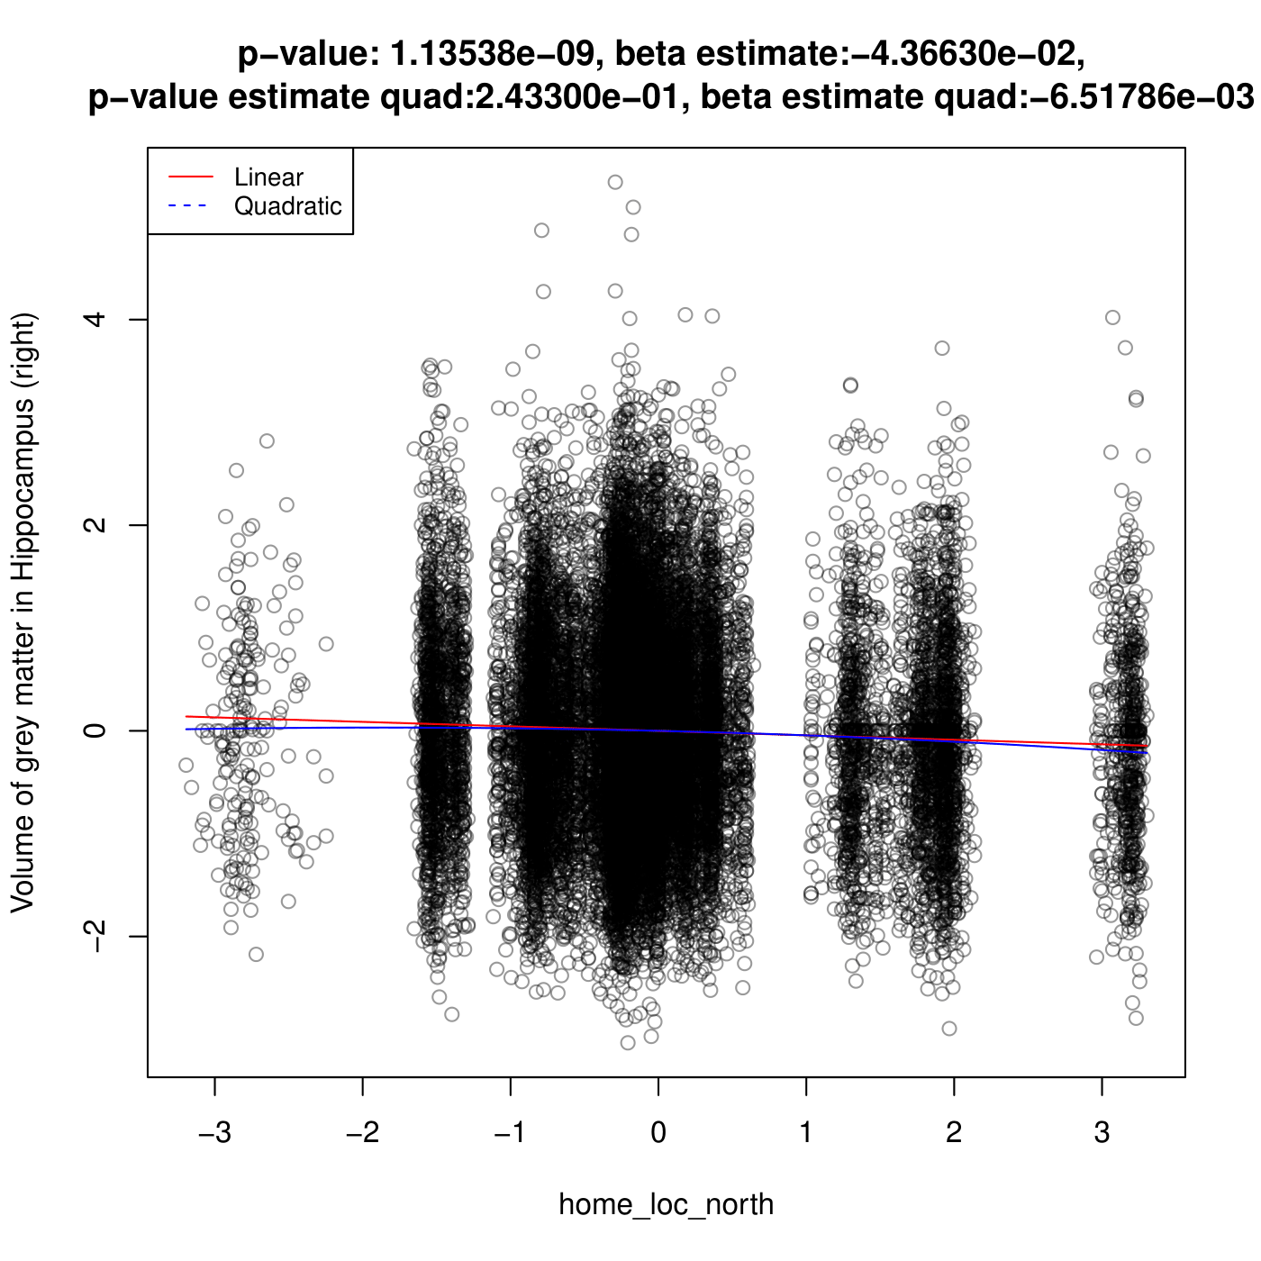
Right hippocampus against home location (north coordinate)
In Alzheimer’s disease, or commonly in ageing, the hippocampus grey matter volume shrinks
The association is relatively weak: We observe significance due to our large sample size, or there are association, but it is quite weak.

Slide 9
Some notable cases and their plots
We fit 137 regions and 15 geospatial variables using linear model
The followings are the plots of notable cases (high beta-estimate or most ‘slanted’ fitted line)
We use model selection methods (BIC and AIC) and choose to stick with linear model with linear term.

Slide 10
Discussion
Hippocampus is associated with consolidating short term memories into long term memories. In Alzheimer’s disease, the hippocampus and its connected structures are often damaged first
The association is relatively weak: We observe significance due to our large sample size, or there are association, but it is quite weak.
The last 2 plots are cases with highest beta-estimate (least-flat plots). They are all hippocampus against home location (north coordinate)

Slide 11
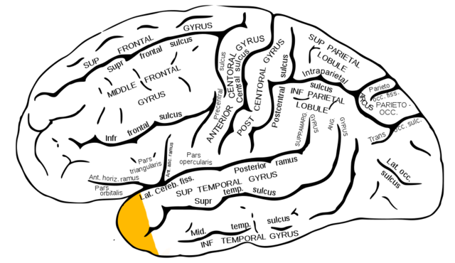
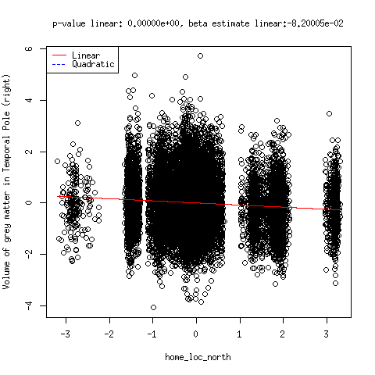
Temporal Pole against home location (north coordinate)
The case with the highest beta estimate among these three is Temporal pole (part of temporal lobe, which is believed to be responsible for visual memories) against home location (north coordinate)

Slide 12
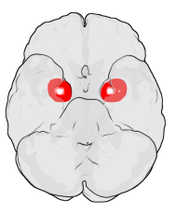
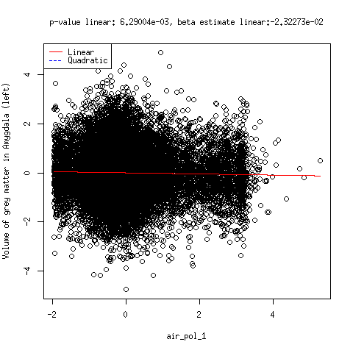
Amygdala against air pollution 1
There are associations between air pollution and the amygdala (which is responsible for emotional memories and is affected later than the hippocampus)

Slide 13
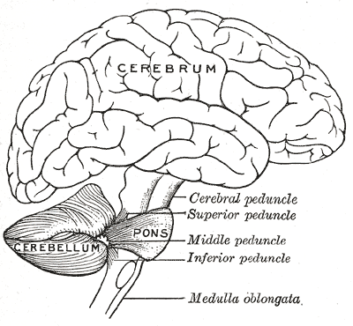
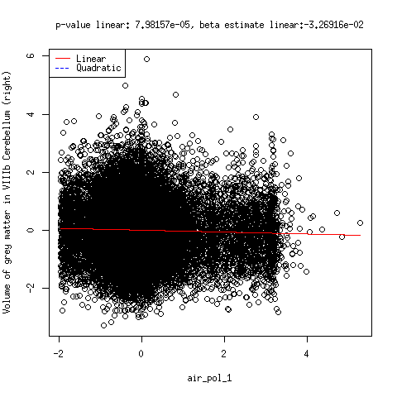
VIIIb cerebellum against air pollution 1
Similar to Amygdala, the volume of VIIIb Cerebellum (an area within the Cerebellum) also suggests an association with air pollution

Slide 14
Results
These are the plots of the cases with the highest beta-estimate (least flat fitted line) among all the cases we investigated (137 brain regions and 15 geospatial variables)
There are associations between air pollution and the amygdala (which is responsible for emotional memories and is affected later than the hippocampus) as well as the VIIIb Cerebellum (an area within the Cerebellum)
The case with the highest beta estimate among these three is Temporal pole (part of temporal lobe, which is believed to be responsible for visual memories) against home location (north coordinate)

Slide 15
Limitations and Improvements
However, for now, we remain skeptical about these results. Since there are factors we have not taken into account in our model yet.
We can further improve the model by considering the structure of geospatial data. In particular, take into account spatial autocorrelation

Slide 16
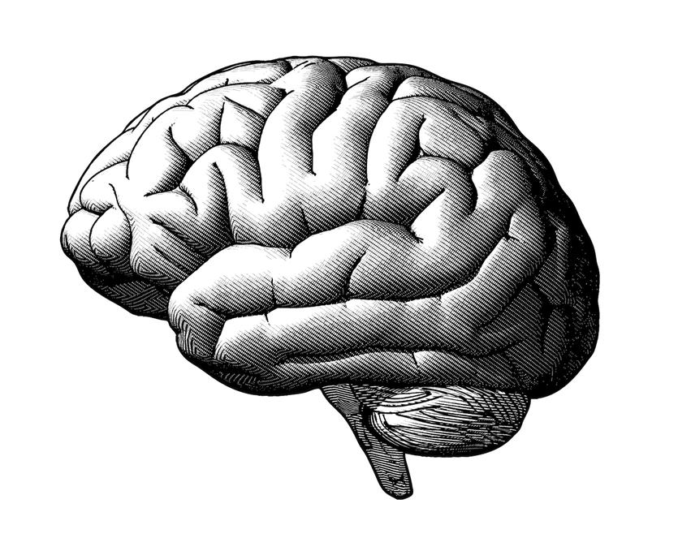
Spatial Autocorrelation visual
Air pollution
Townsend
Green space
Home location
Geographical Area 1
Geographical Area 3
Geographical Area 2

Slide 17
Discussion and Summary
From our findings, we have found some association between the grey matter volume in hippocampus, Temporal Pole and north coordinate of home location.
The following cited papers highlight the higher rates of dementia in the north compared to the south in other countries (Italy, Scotland, Sweden, China).
If we hypothesize that the UK follows this trend, the above result can be one of the motivations for further investigation.

Slide 18
References
[1] Russ, T.C., Murianni, L., Icaza, G., Slachevsky, A. and Starr, J.M., 2016. Geographical variation in dementia mortality in italy, new zealand, and chile: The impact of latitude, Vitamin D, and air pollution. Dementia and geriatric cognitive disorders, 42(1-2), pp.31-41.
[2] Russ, T.C., Gatz, M., Pedersen, N.L., Hannah, J., Wyper, G., Batty, G.D., Deary, I.J. and Starr, J.M., 2015. Geographical variation in dementia: examining the role of environmental factors in Sweden and Scotland. Epidemiology (Cambridge, Mass.), 26(2), p.263.
[3] Wu, Y.T., Lee, H.Y., Norton, S., Chen, C., Chen, H., He, C., Fleming, J., Matthews, F.E. and Brayne, C., 2013. Prevalence studies of dementia in mainland China, Hong Kong and taiwan: a systematic review and meta-analysis. PLoS One, 8(6), p.e66252.

Slide 19
Thank you for your attention!

